Slide 1

A Guide On…
How To Start Making Games On Your Own

Slide 2
Before we start…
I assert you never touch game making and someone who have ever loved you
I only worked (and is currently working) on a project before, feel okay to tell me that I’m a loser
Questions can have various answers and different approaches, feel free to tell me that my method is as dumb as I am
Still many things I haven’t figure out on my own, I might not be able to gives a perfect answer (and feel right to say that my answer is shit)
Anyways, I’m not professional, you are encouraged to say GFYS

Slide 3

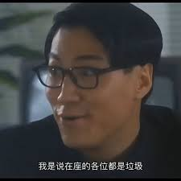

Prologue
Q1: The least needed person in a small group of game develop
Answers: Programmer (You)
Reasons:
At small scales, some Game Designer can do it
At relative bigger scales, still can be done if no complex things get around
Non-programmer-friendly engines like GameMaker
AI (Not likely if things get bigger or buggier)

Slide 4
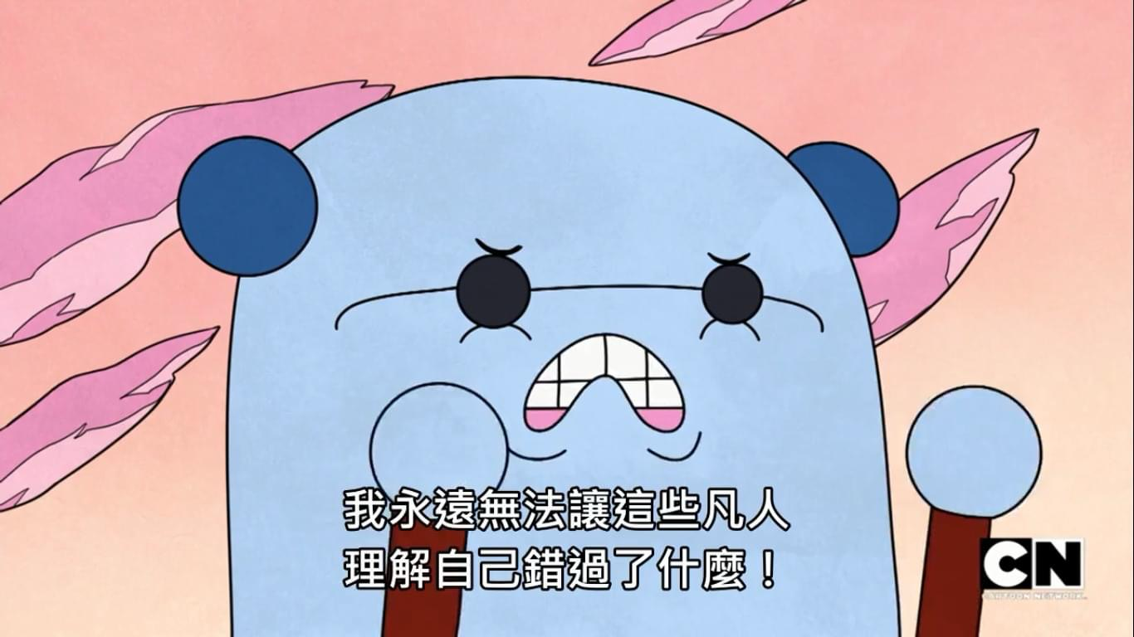
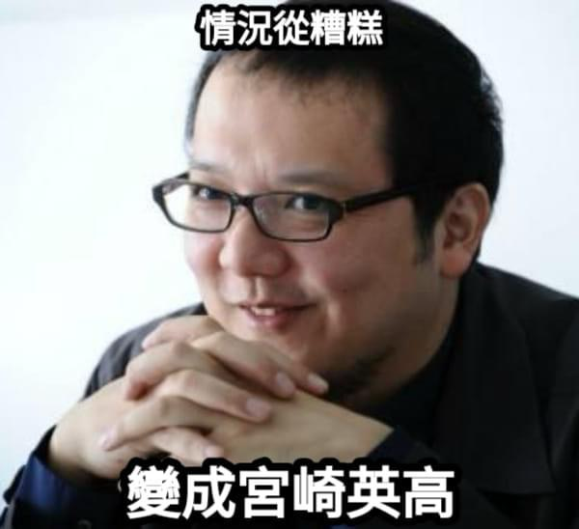
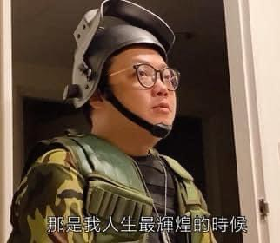
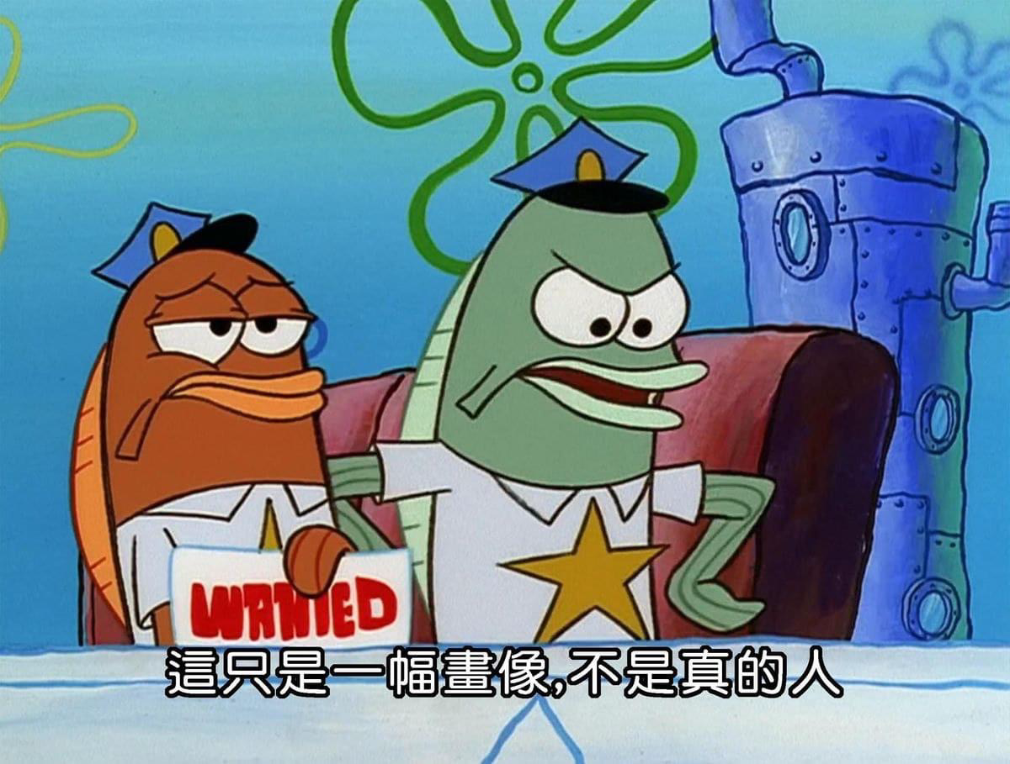
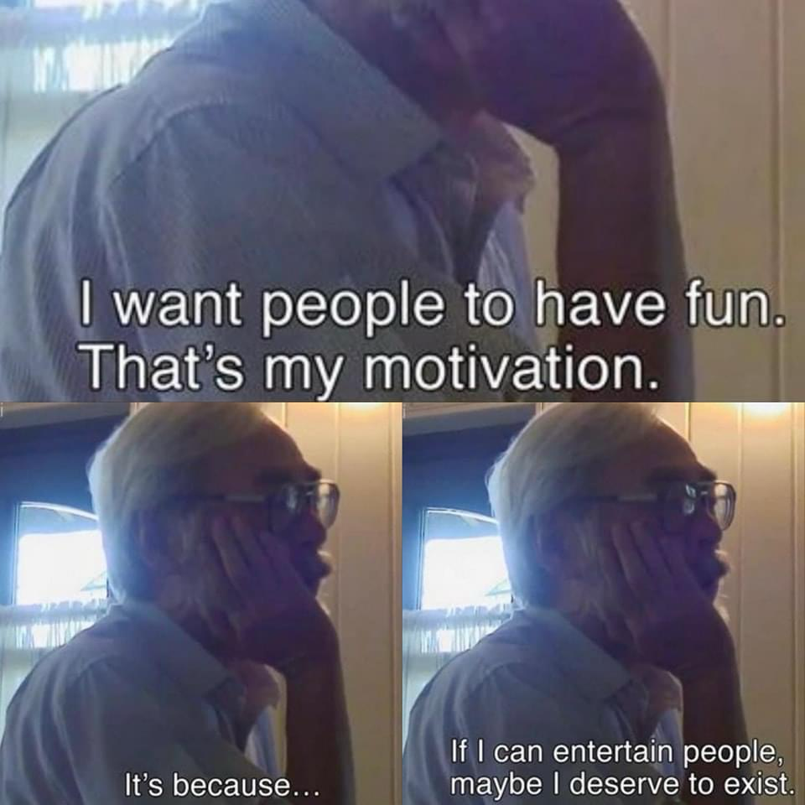
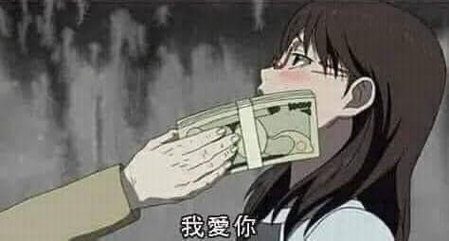
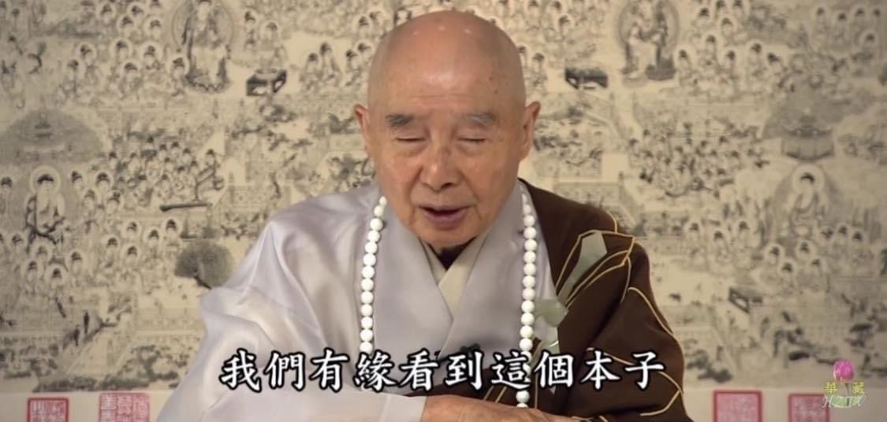
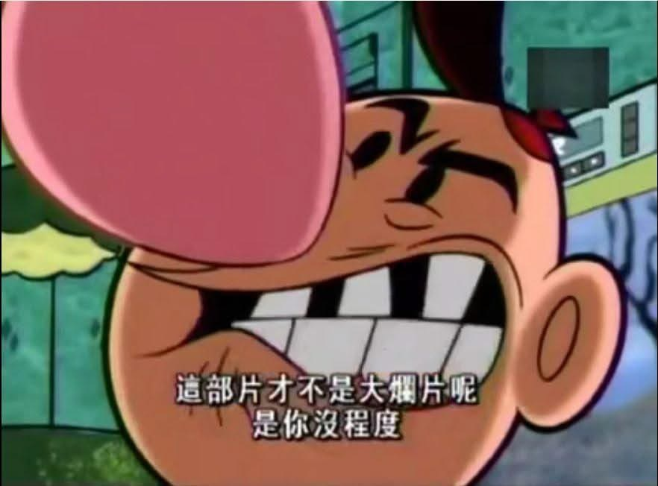
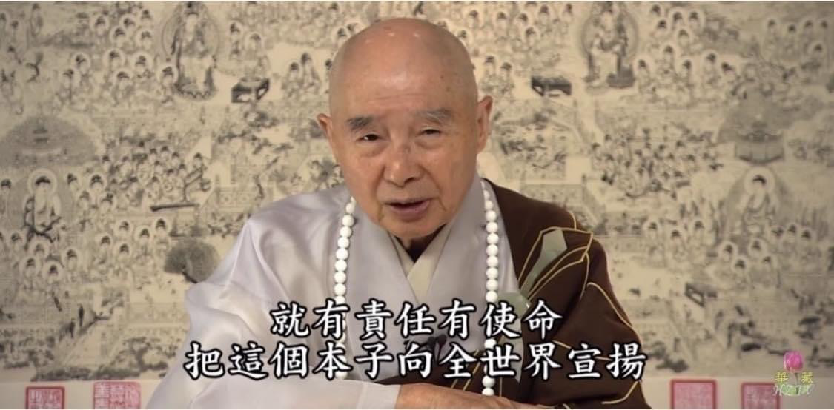
Prologue
Q2: Why do people want to make it?
Answers: A lot reasons
Notes:
有想要和人分享的樂趣
錢
為了做出一個蔚藍檔案（有想要做的角色類型）
覺得自己單純很適合做遊戲
想要做一個自己著迷的遊戲類型

Slide 5
Prologue
Q3: Can you tell me what this program needs aside from any scripts?
https://www.youtube.com/watch?v=pqVBEZzHGVM&ab_channel=devilleon7

Slide 6
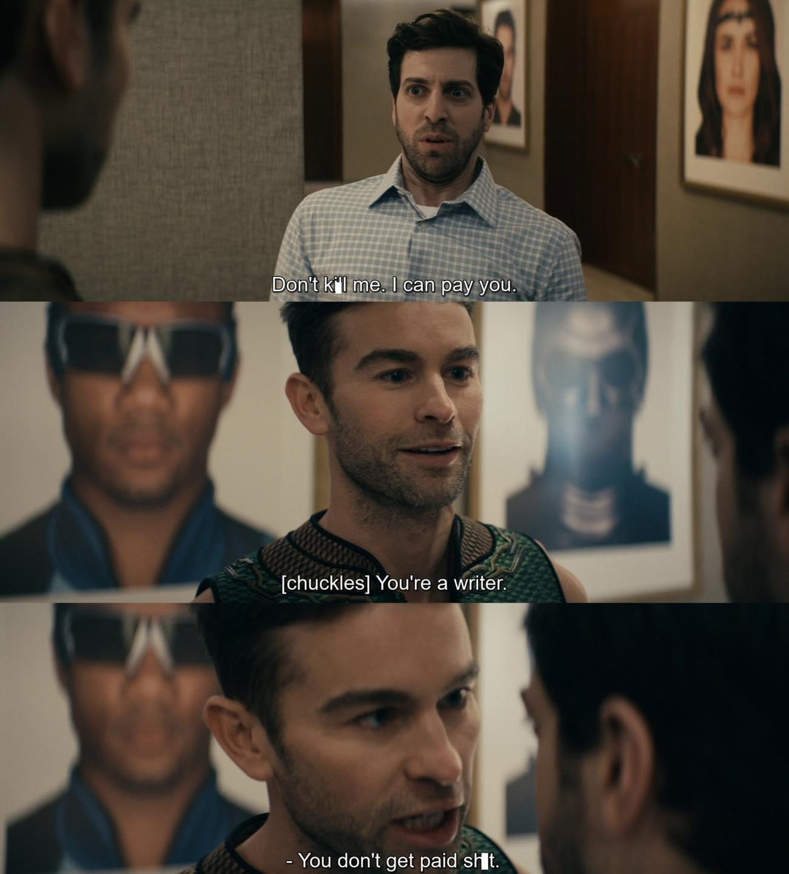
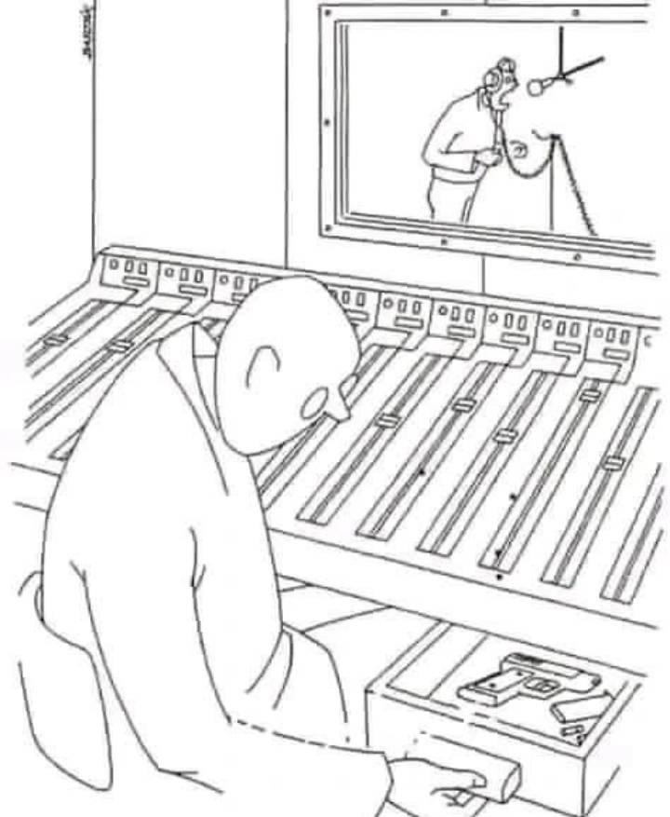
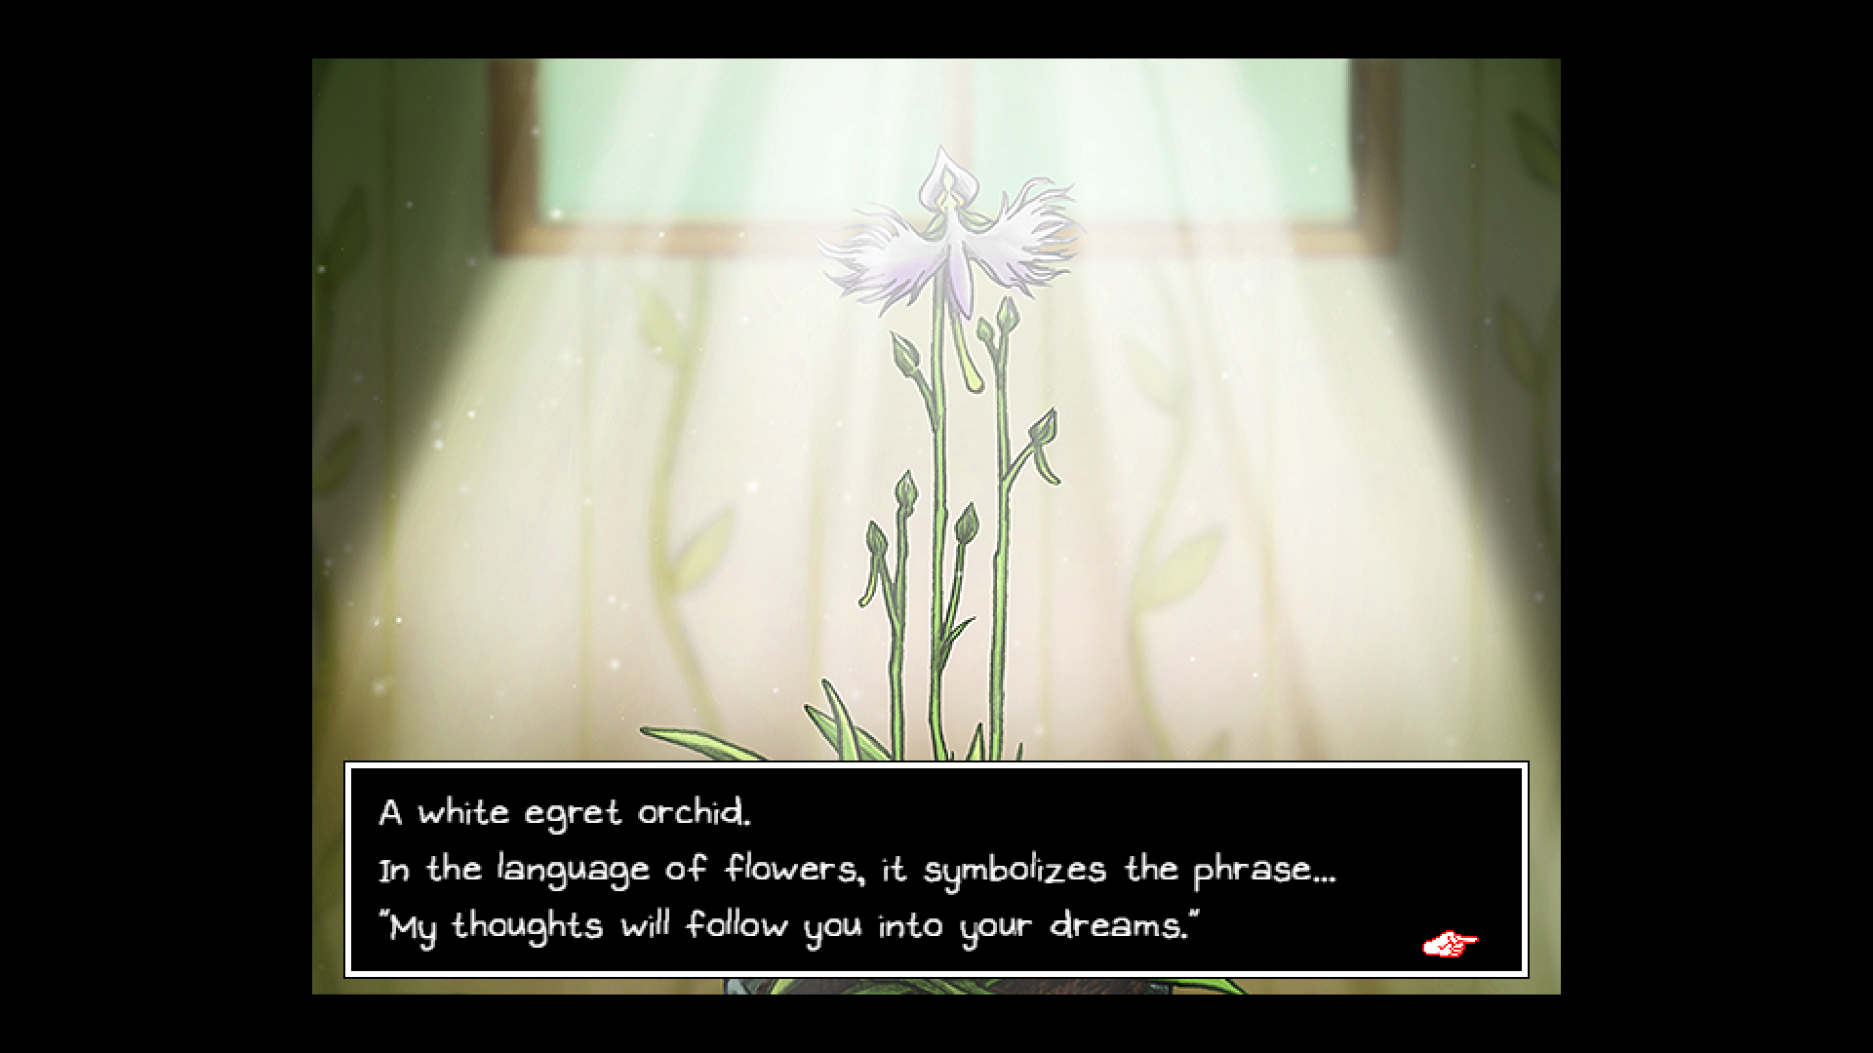
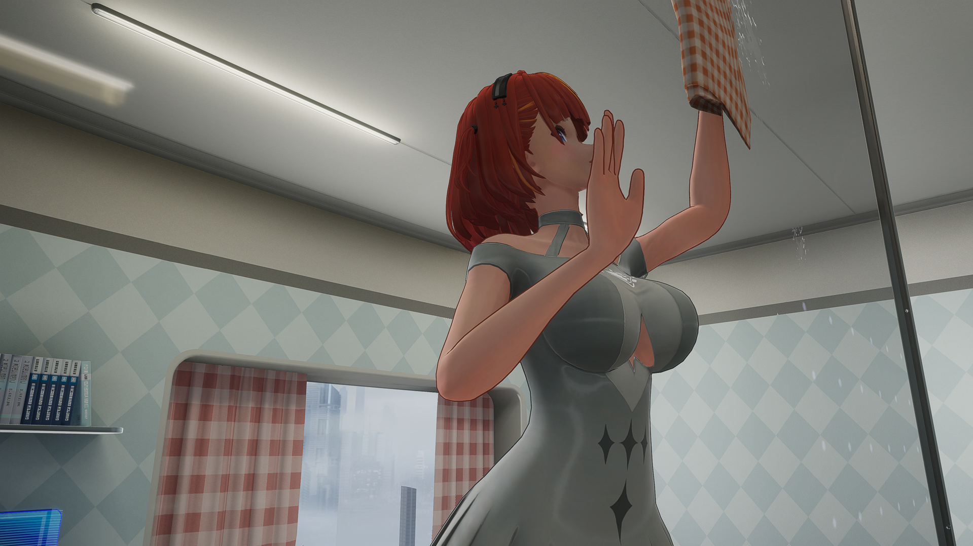
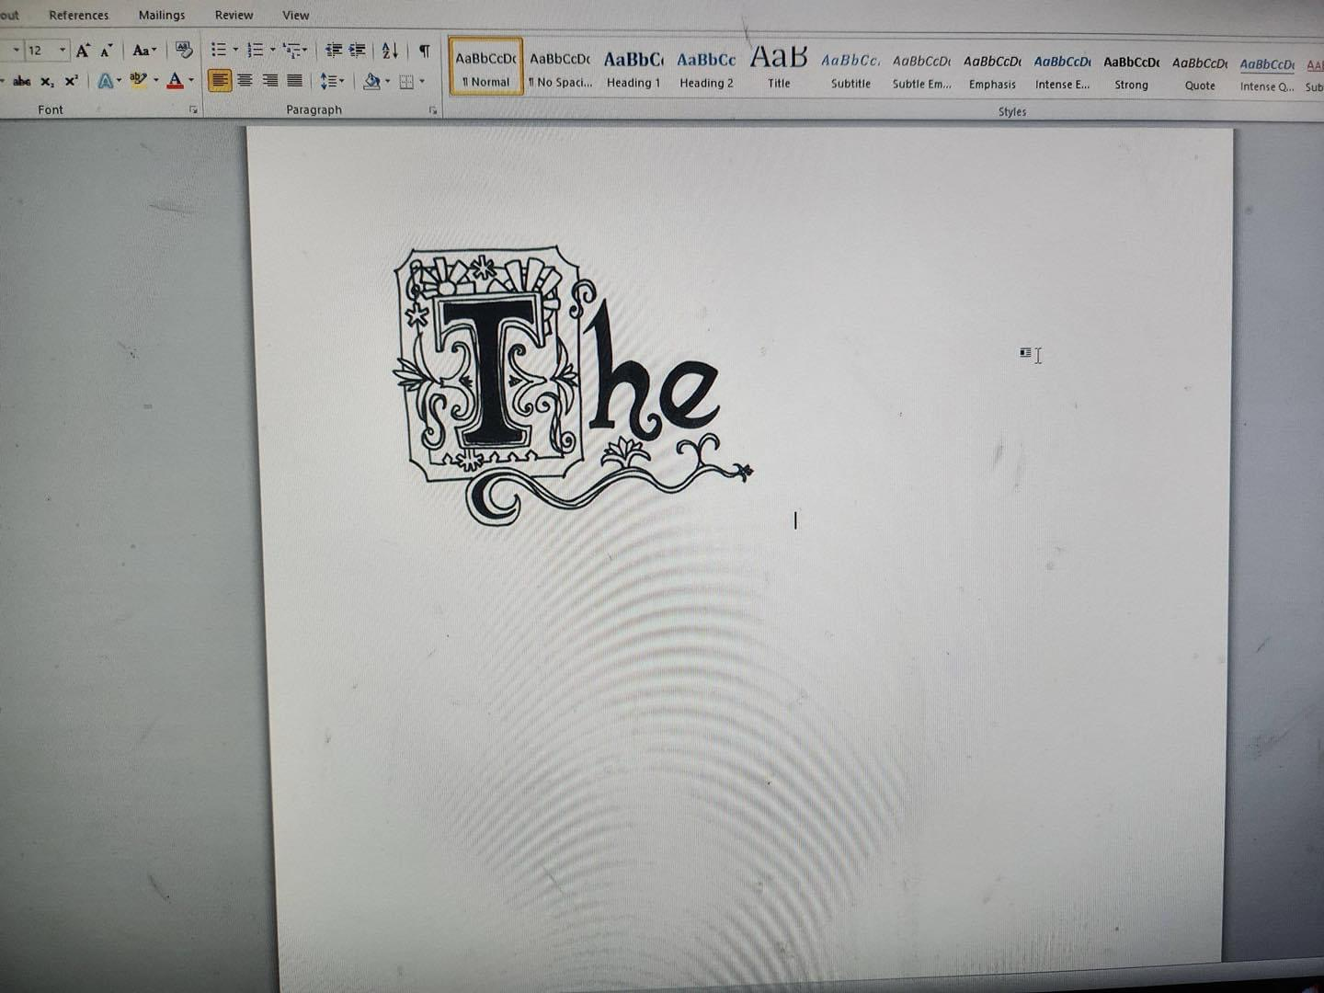
What A Games Needs
Generally speaking:
Game Designer
Artist
2D Animation/Character etc.…
3D Animation/Model etc.…
Writer
Composer/Arranger/Sound Engineer

Slide 7
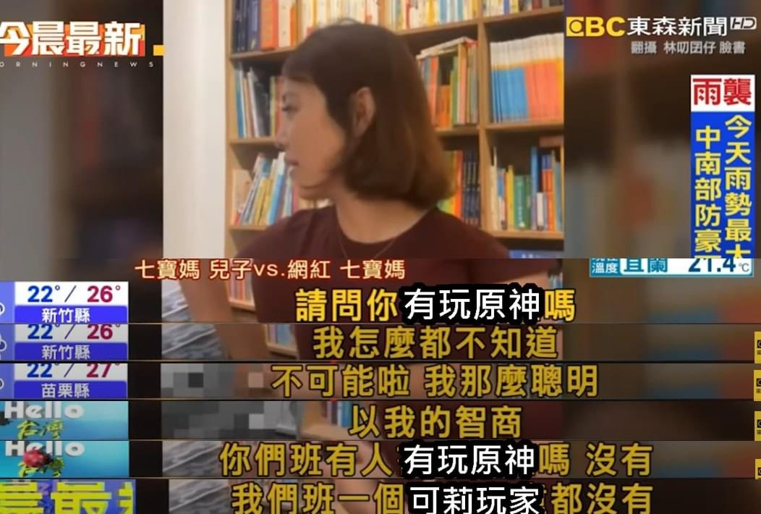

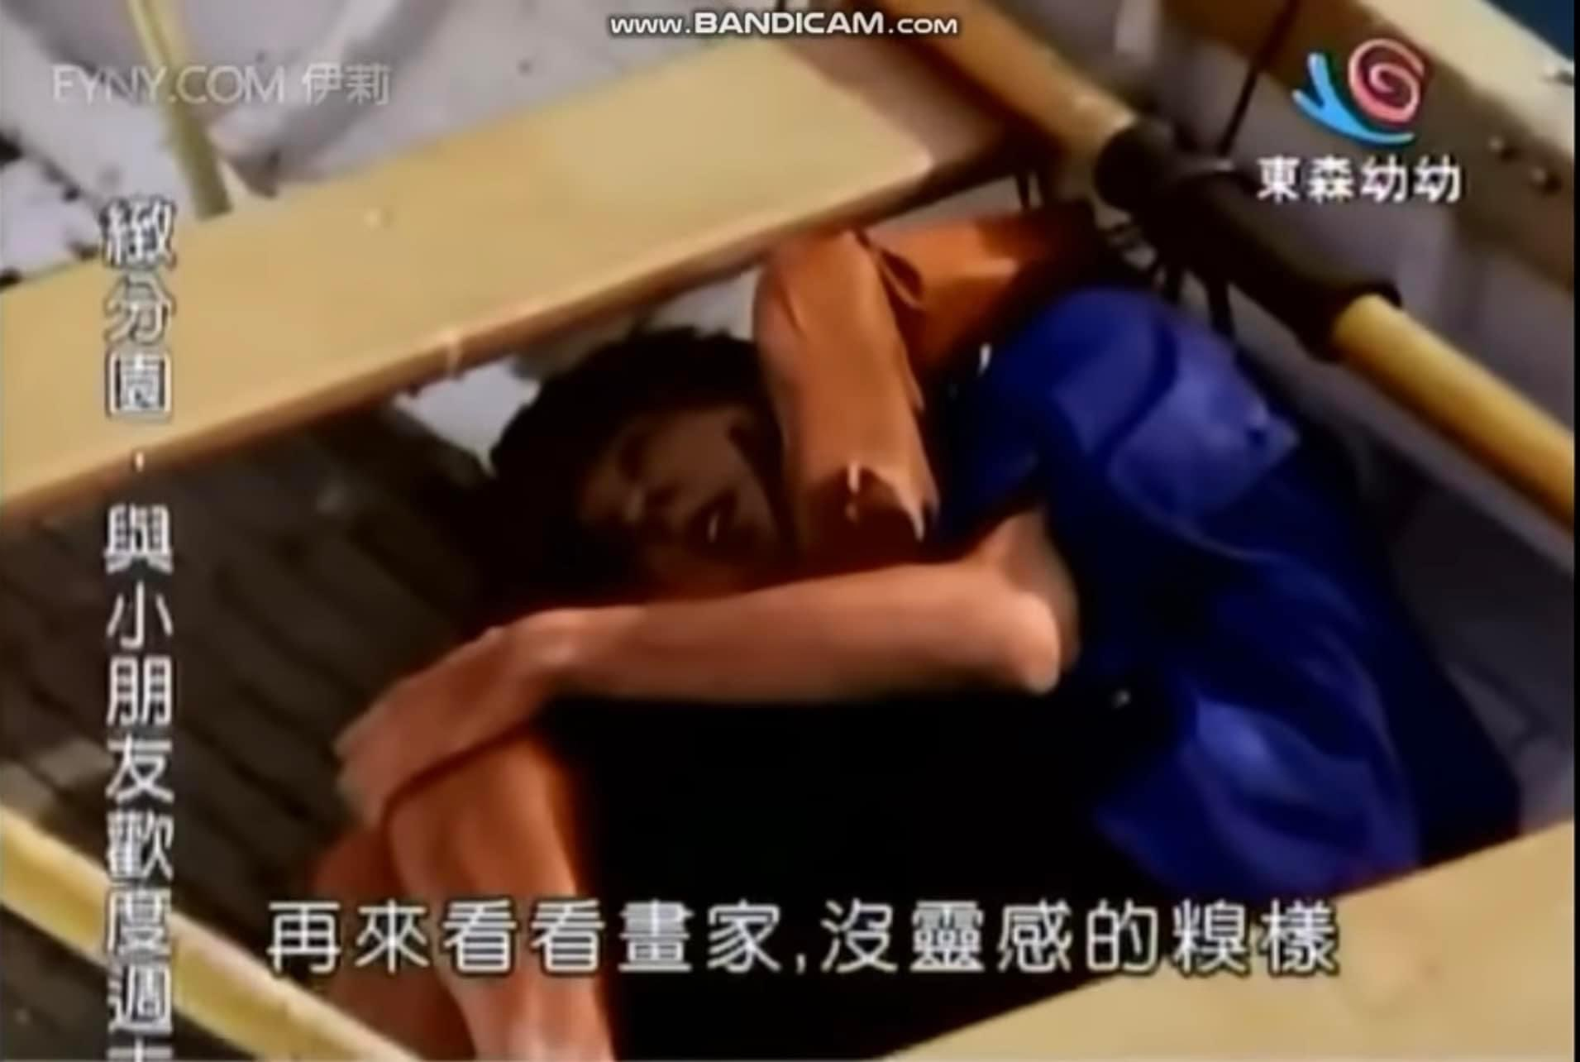
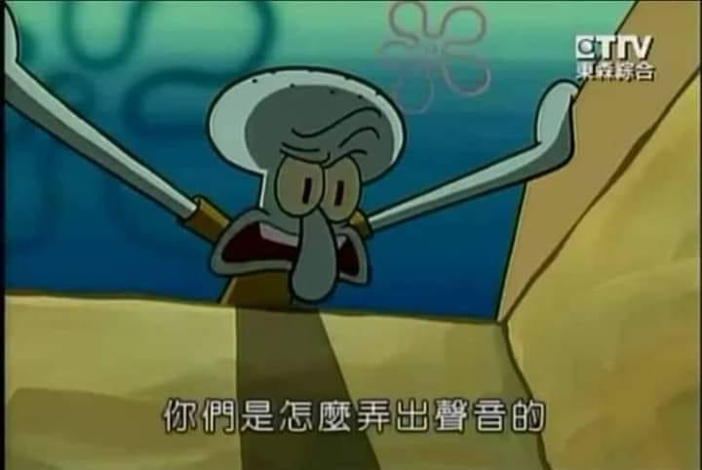


What A Game Needs
When you look thoroughly, you’ll have few questions:
Do I need to love playing games?
Do I need to be good at programming?
Do I need to know how to draw?
WTF is composing and arranger?
Would my never-finish-writing style work on game story scripting?
What if I can’t do any of this shit?
Damn, making a game is hard

Slide 8
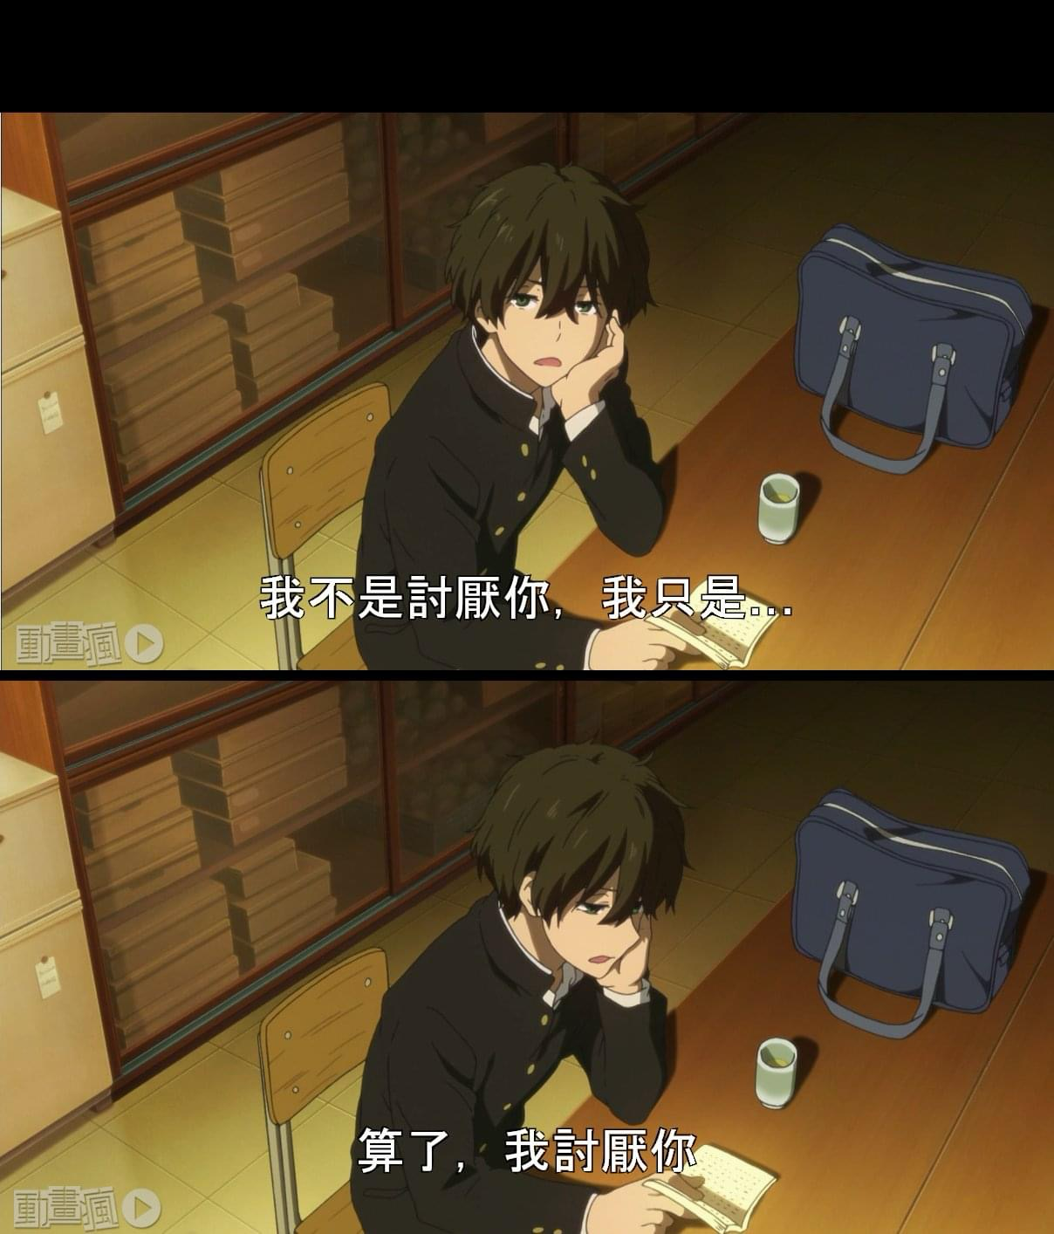
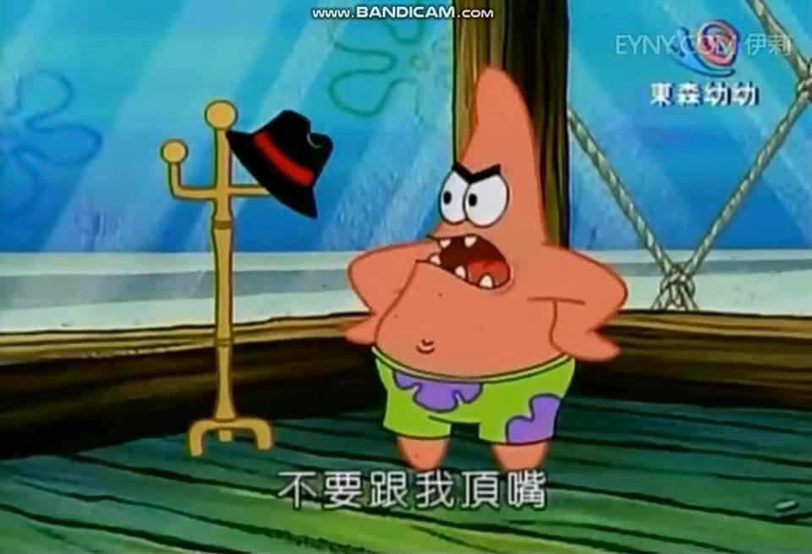
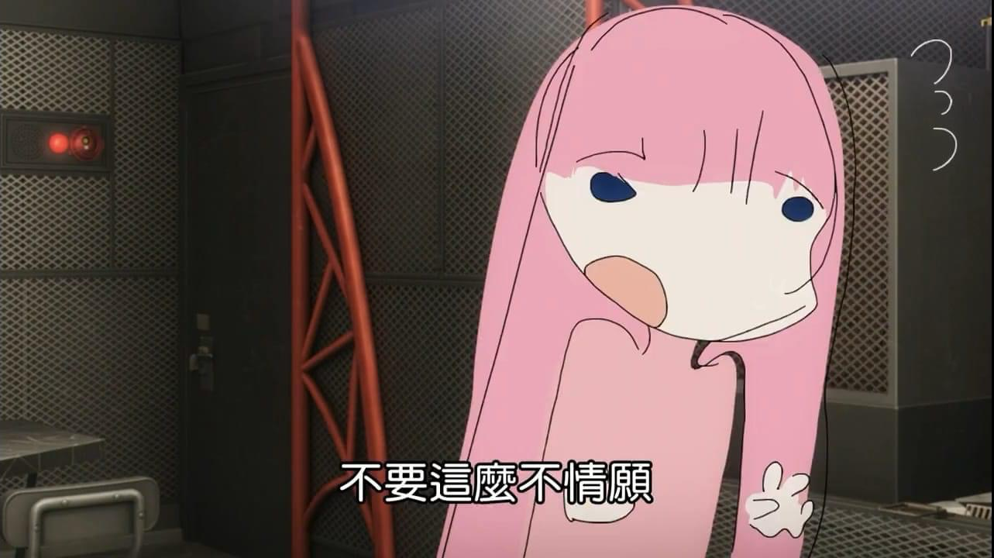
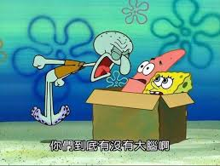
What A Game Needs
Answer: Teamwork
And it is teamwork from alternative professions!
And you’d probably do these often:

Slide 9
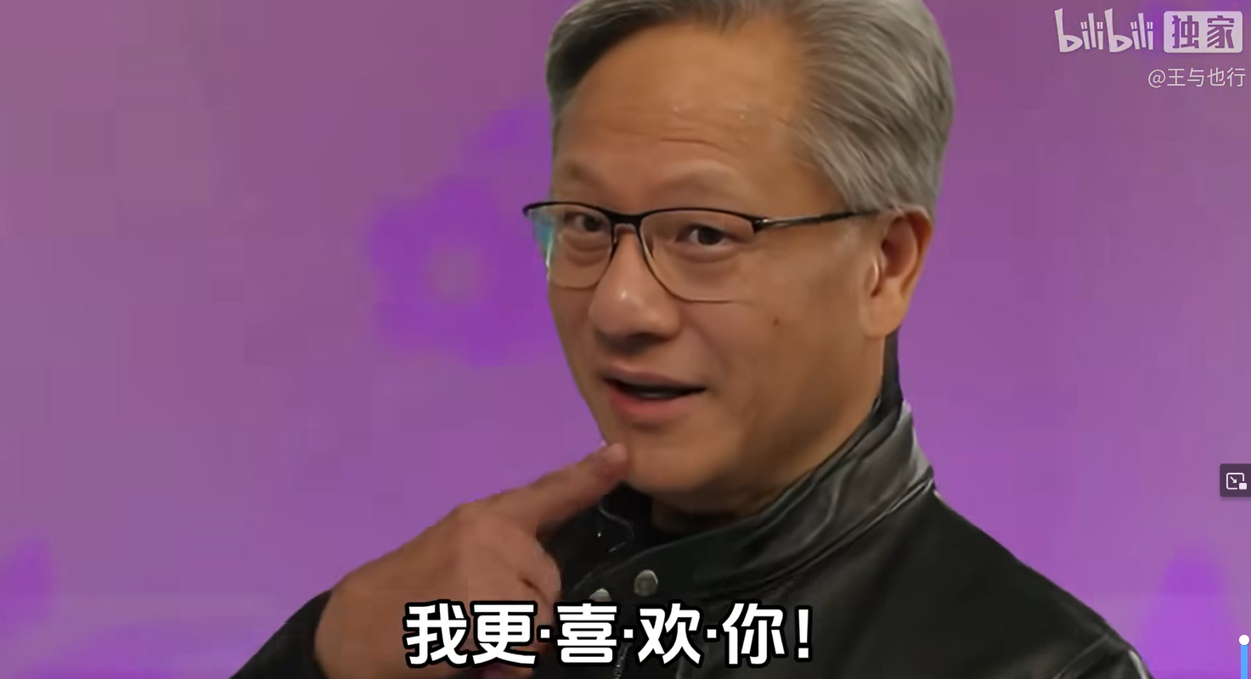
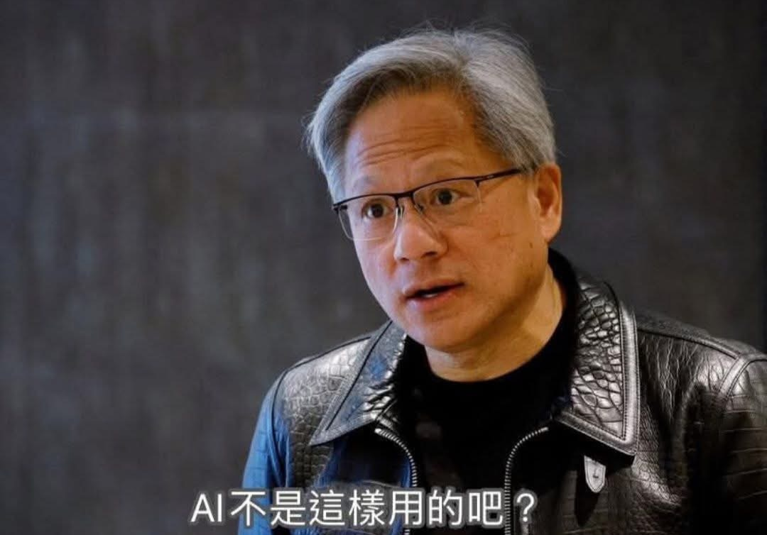

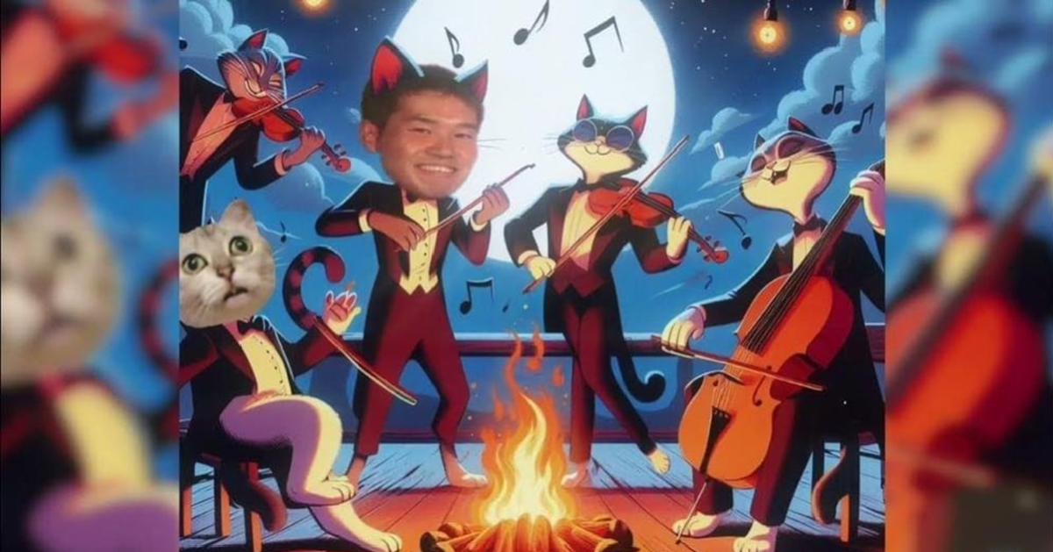
AI for all?

Slide 10
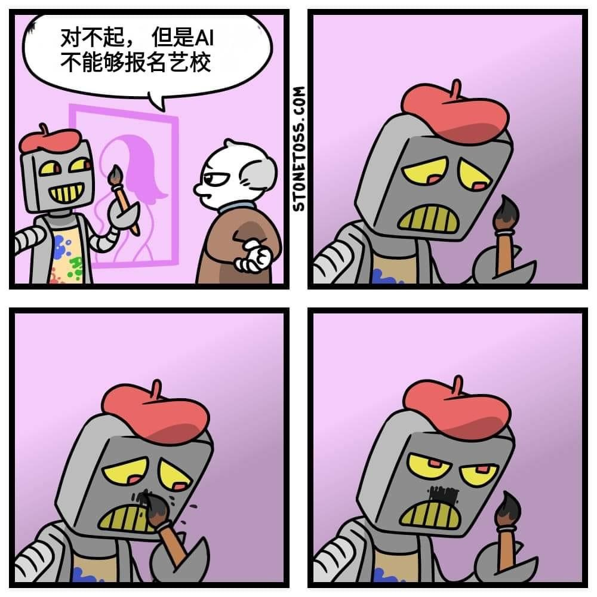

AI for all?
🎨 Artists
AI can assist and even generate original visuals, but:
Yes: AI can create digital art, logos, illustrations, and style transfer (e.g., turning photos into Van Gogh-style paintings).
But: It lacks human intent, nuance, and emotional depth. It doesn’t "feel" what it’s creating. Many artists use it as a tool, not a replacement.
🎼 Composers
Yes: AI can generate music — melodies, harmonies, even entire tracks in various genres.
But: It's still formulaic unless guided by a human. It doesn't know why a certain chord progression is emotionally powerful — it just mimics patterns.
Some composers use AI to spark ideas or fill in gaps.
🎧 Sound Engineers
Yes, partially: AI can mix/master tracks, clean up audio, remove noise, and even replicate specific styles or tones.
But: The human ear and taste still reign supreme in final mixes, especially in complex, high-stakes productions (like film or professional albums).
📝 Writers
Yes, definitely: AI (like me 😄) can write essays, stories, scripts, ads, emails, etc.
But: It still needs a strong human editor or guide to ensure emotional resonance, originality, and contextual accuracy.
For certain niches (like technical writing or content marketing), AI can do a lot.
🧠 Planners (e.g., project managers, urban planners, event planners)
Yes, with limits: AI can suggest schedules, optimize logistics, recommend layouts or city planning models based on data.
But: Human planners excel at managing people, politics, emotions, and context. AI doesn't understand local culture or unspoken dynamics.
Can AI do jobs of
Game Designer/Artists/Composers/Sound Engineers/Writers?
Short Answer: no
Long answer:
Basically is as same as
why AI can’t replace you currently
They don’t know how

Slide 11
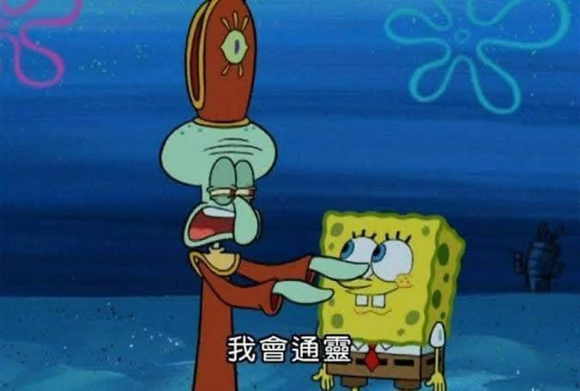

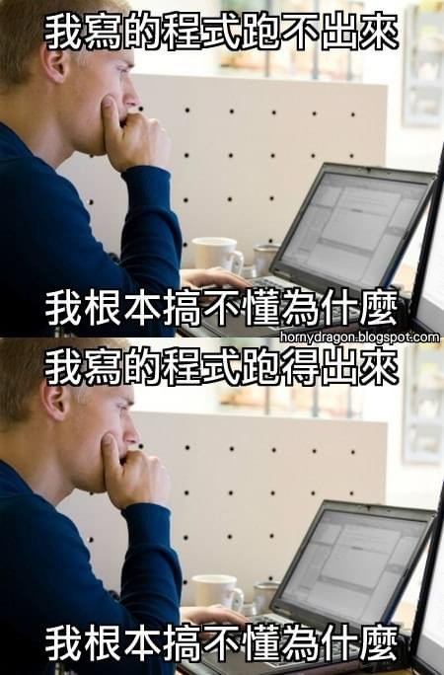
What A Game Needs Programmer for
So, What A Game Needs Programmer for?
To complete the program logic thoroughly
To predict if planning ways is truly available
To make sure the program runs smoothly (on any platform)

Slide 12
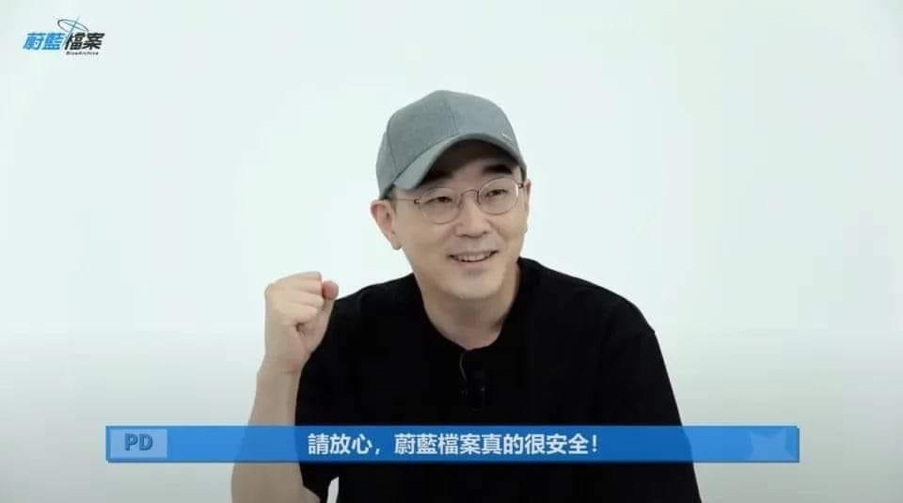

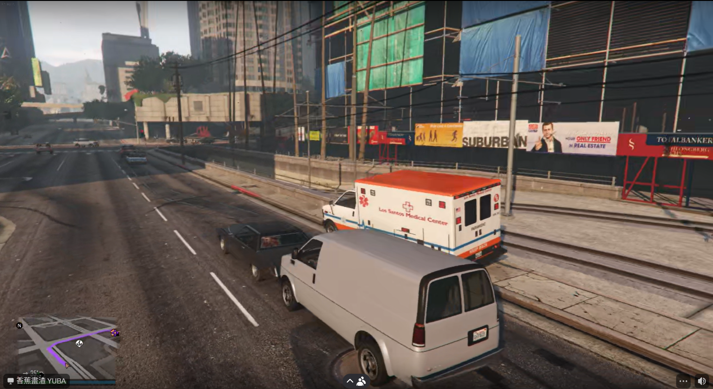
What A Game Needs Programmer for
Programmer
Multiplayer Arch: Front-End/Back-End/Database
Singleplayer Arch: Front-End/Game Engine (partially Front-End and partially Back-End)

Slide 13


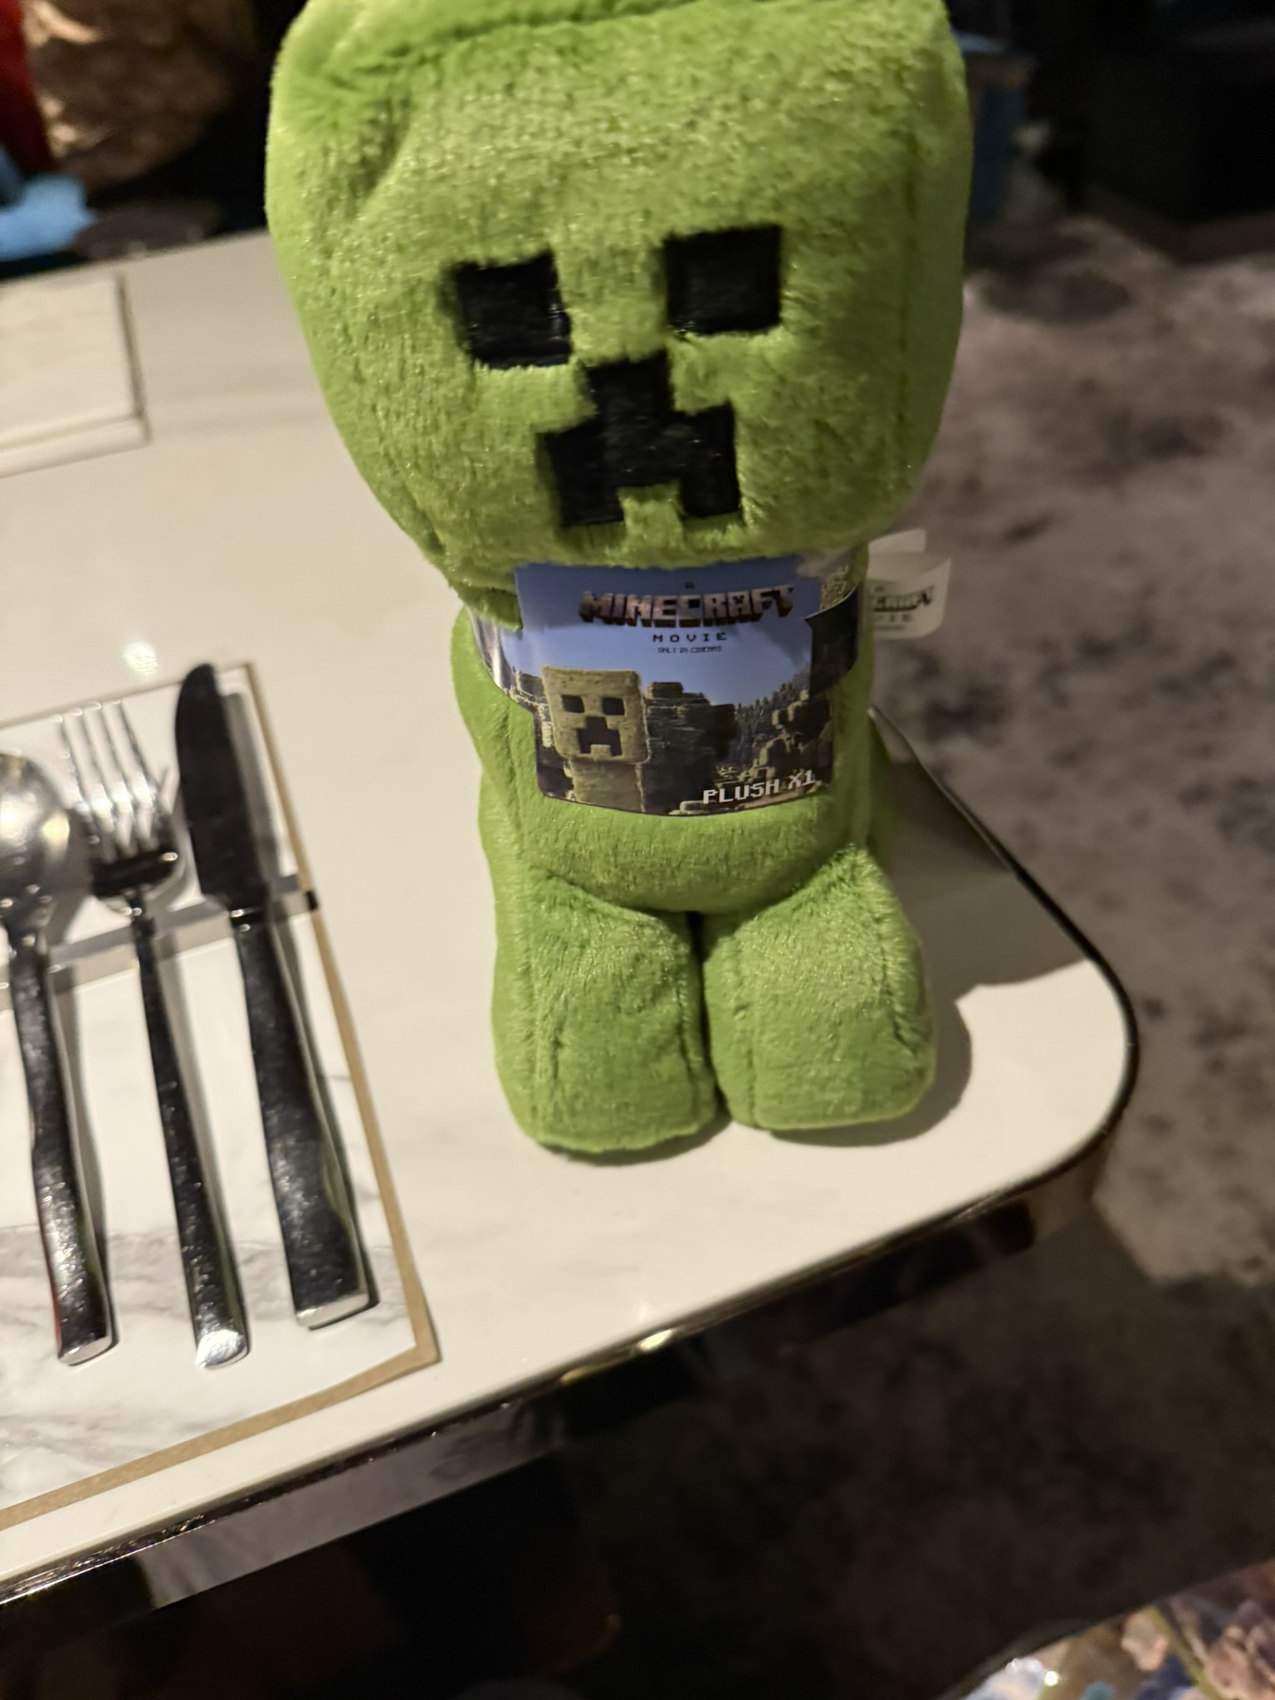
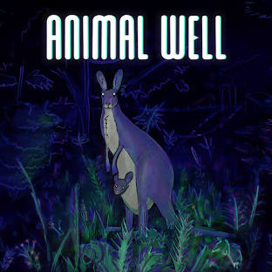


Tools to write games

Slide 14
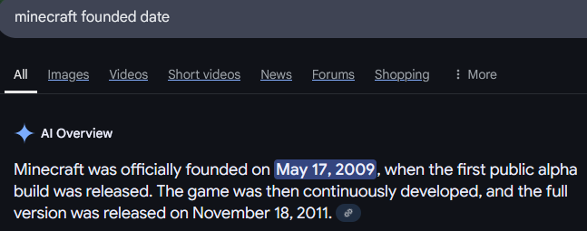
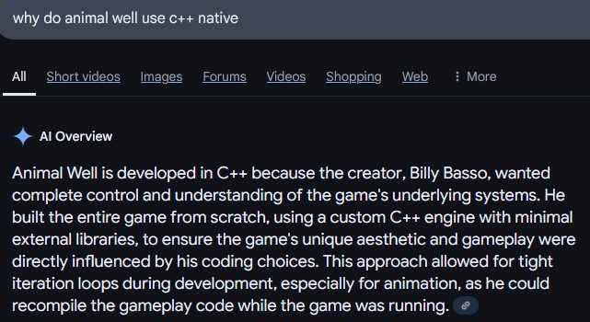
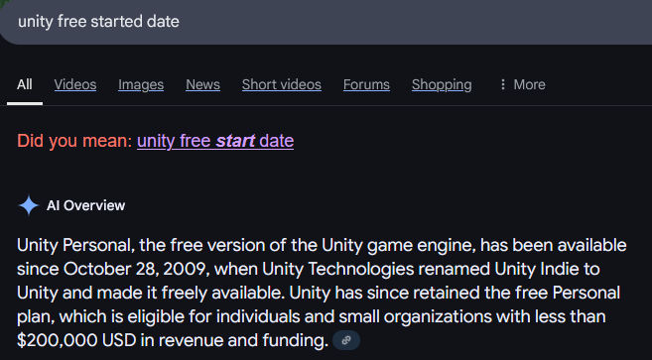
Why use native

Slide 15
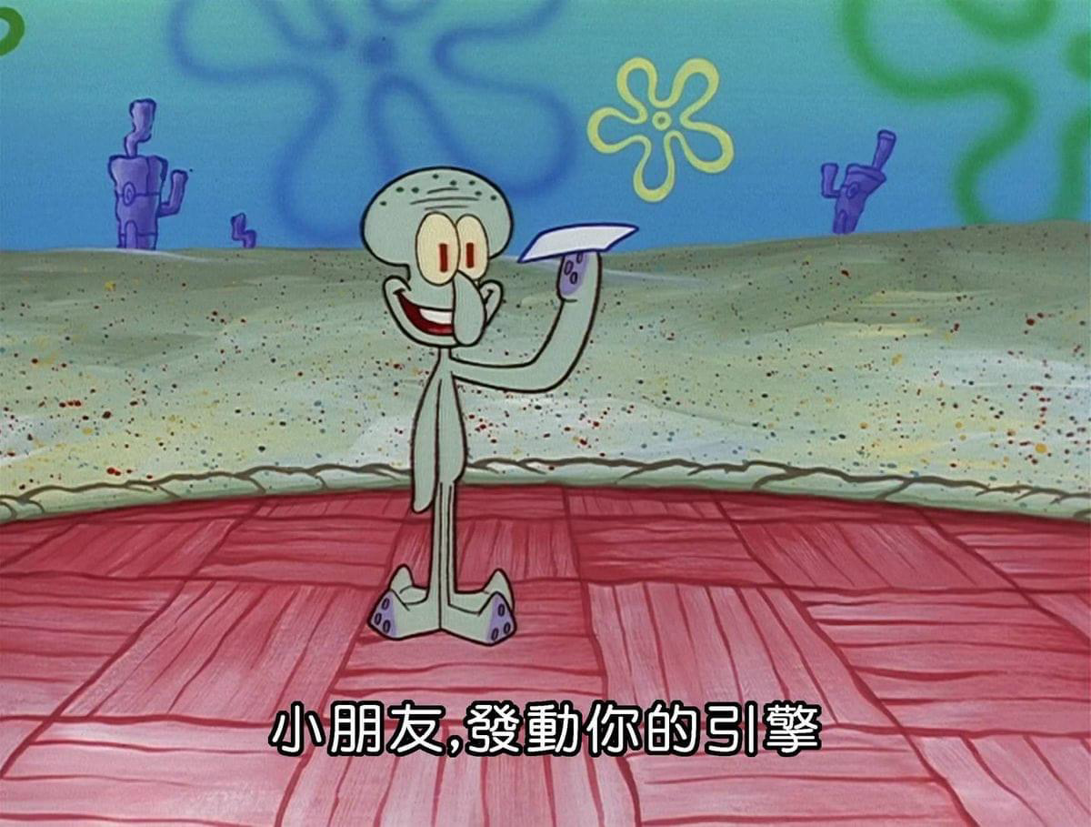
What is Game engine
Unity Engine
Rendering/
Physics/
Audio/
Input/
game loop/
everything heavy-duty etc…
Scripting API/Scripting Layer
Your code
Scan for Unity Event functions abstractly
Unity Components

Slide 16

Why use Game engine
Answer: Unless you wanna make Rendering/Physics/Audio/Input/game loop etc… urself
Here’s the Pattern list you needs to look up before getting started:
Component Pattern
Game Loop Pattern
State Pattern
Command Pattern
Prototype Pattern
Object Pool Pattern
Service Locator Pattern
Factory Pattern
Strategy Pattern
Mediator Pattern
Flyweight Pattern
Decorator Pattern
MVC / MVVM Pattern
Dependency Injection Pattern
Iterator Pattern
Event Queue Pattern
Template Method Pattern
Service Pattern

Slide 17
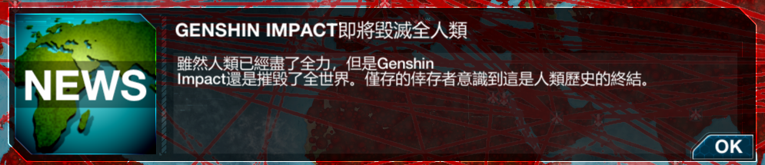


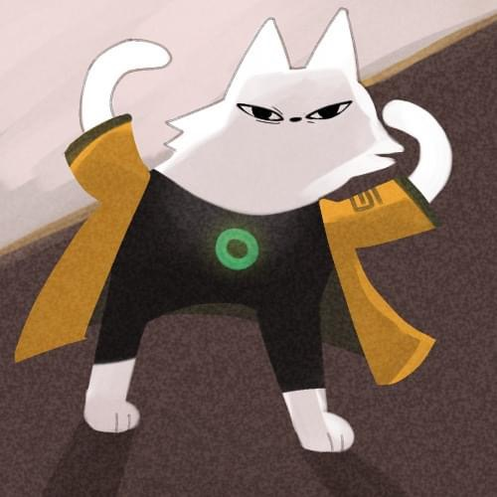
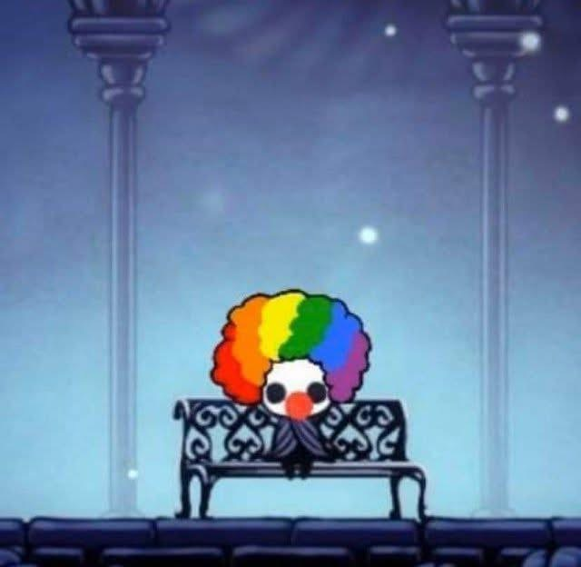
Tools to write games

Slide 18
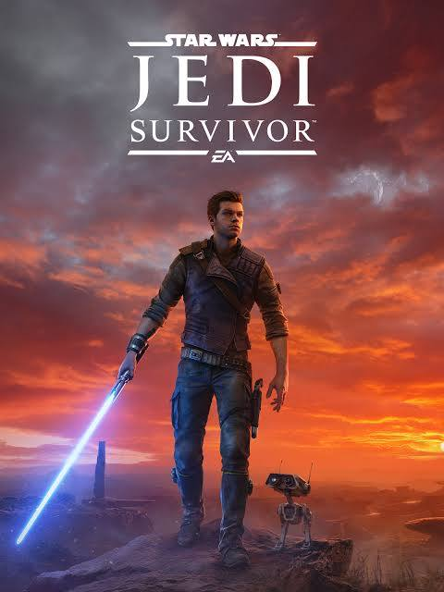
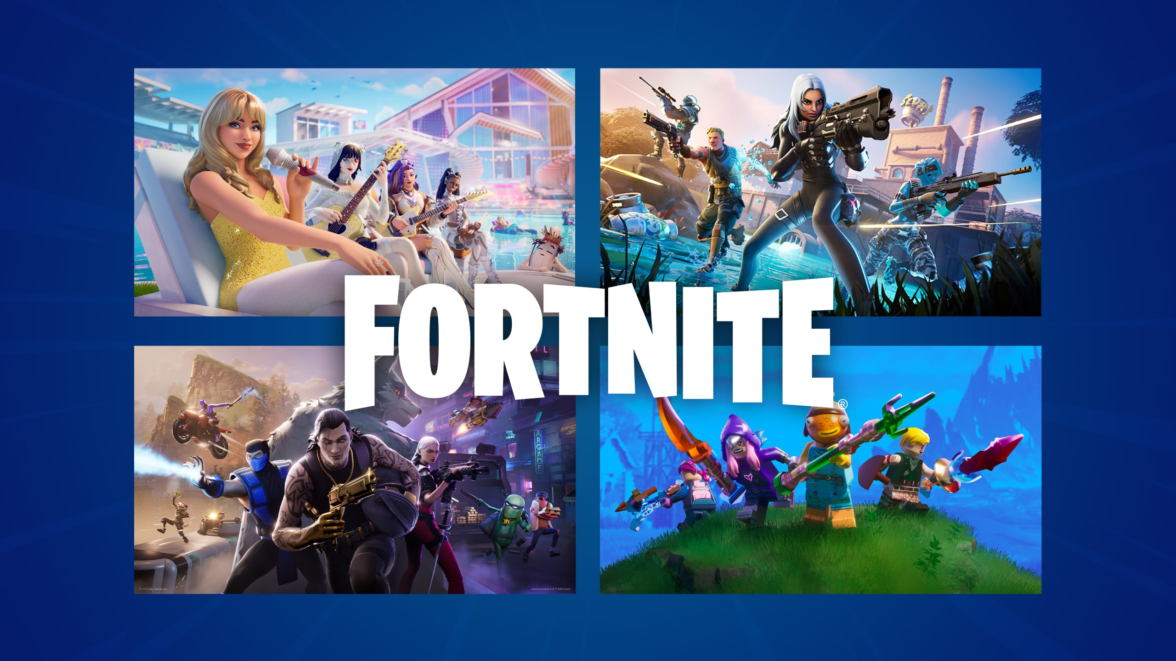
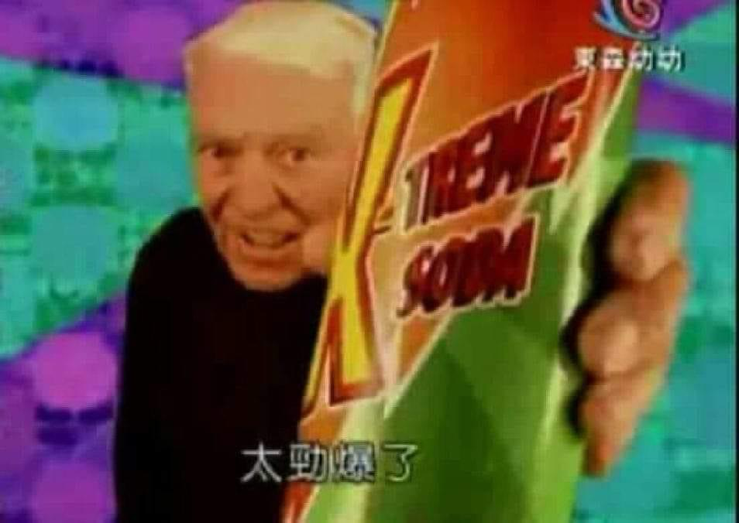

Tools to write games

Slide 19
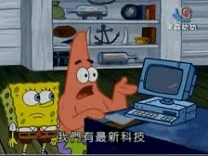
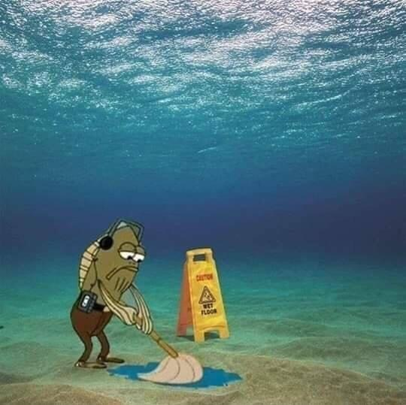

Tools to write games

Slide 20
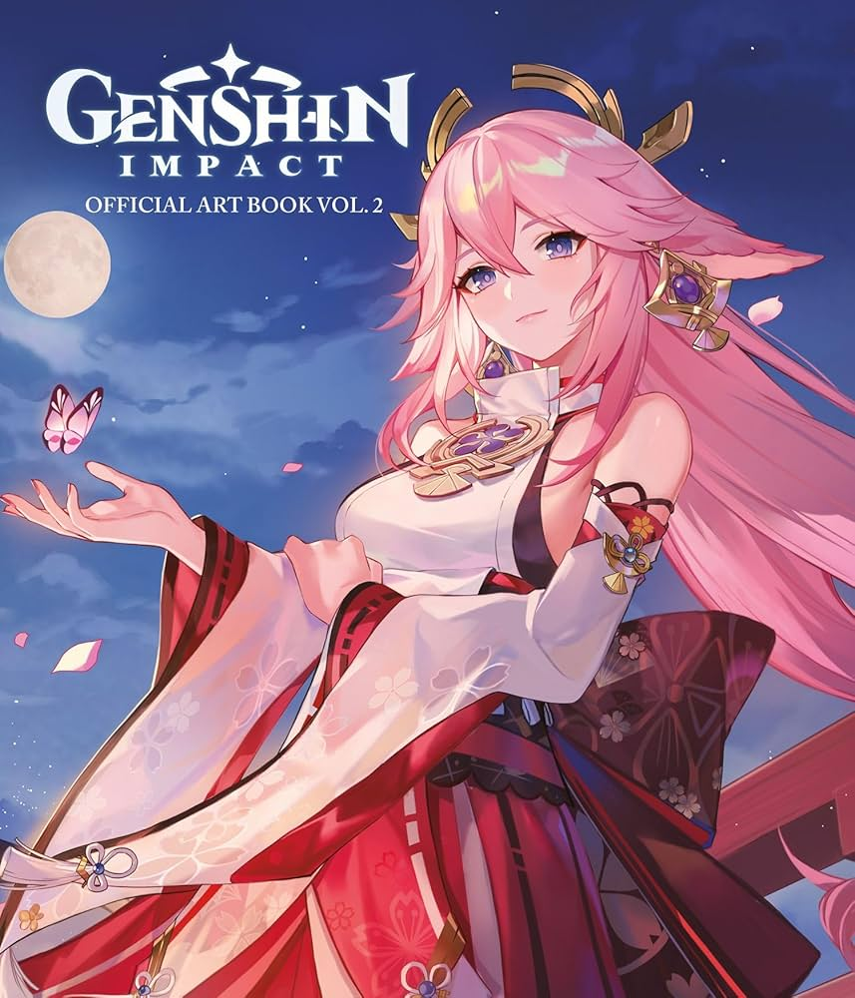

Steps on make first game…
Start things simple
You don’t make whole Genshin Impact at first (Neither do MiHoYo)
Set a small target (e.g. Flappy Bird, Chess)

Slide 21

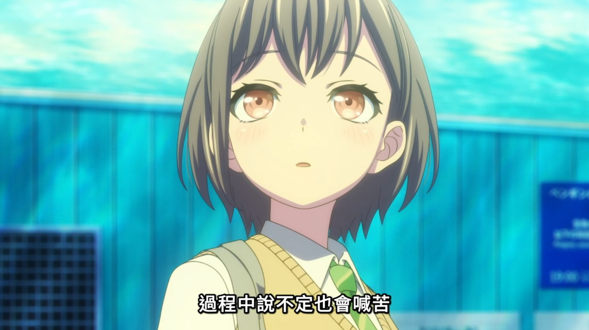

Identify what to write
e.g. Flappy Bird
How would it start
How would it process
How would it end

Slide 22
Identify what to write
e.g. Flappy Bird
How would it start
How would it process
How would it end
How would player play the game?
What info would player see before game start?
What input we should listen to?
Gravity and Adding Force
Collision on scene object hit
How would we display score
Maybe we can replay?
What info would we store? (e.g. highest score)

Slide 23

Identify what to write
e.g. My own cases
How would it start
How would it process
How would it end

Slide 24

Why OOP/Software Engineering matter
SOLID
Single responsibility
Open–closed
Liskov substitution
Interface segregation
Dependency inversion
On a small scale, these don’t matter
In recent years, more OOP are introducing into Unity (e.g. Input System)
Translations: Fetch similar shit and put together
Another translations: You don’t take responsibility on other’s code
Notes:
單一功能原則 認為「對象應該僅具有一種單一功能」的概念。
開閉原則 認為「軟體應該是對於擴充開放的，但是對於修改封閉的」的概念。
里氏替換原則 認為「程式中的對象應該是可以在不改變程式正確性的前提下被它的子類所替換的」的概念。 參考契約式設計。
介面隔離原則 認為「多個特定客戶端介面要好於一個寬泛用途的介面」的概念。
依賴反轉原則 認為一個方法應該遵從「依賴於抽象而不是一個實例」的概念。

Slide 25
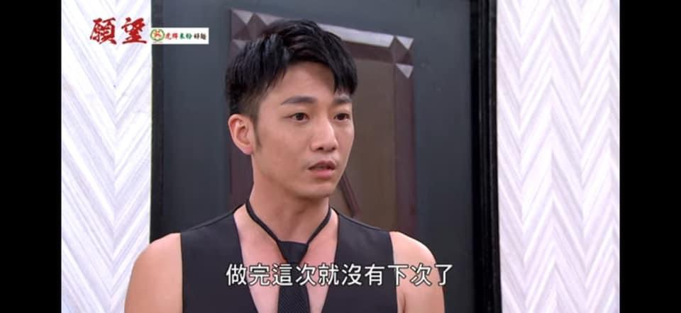
Epilogue
Start things simple
Identify what your need is
Learning OOP/Software Engineering would help, but it just optional at start (You eventually would felt need it as project scale goes up)
And most important
Do it everyday, you little piece of potato

Slide 26
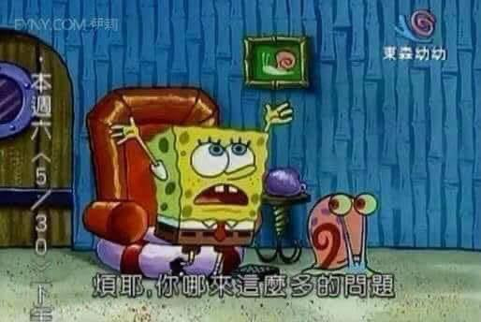
Q & A

